Slide 1


Guide to use TestLink
For test leader role

Slide 2
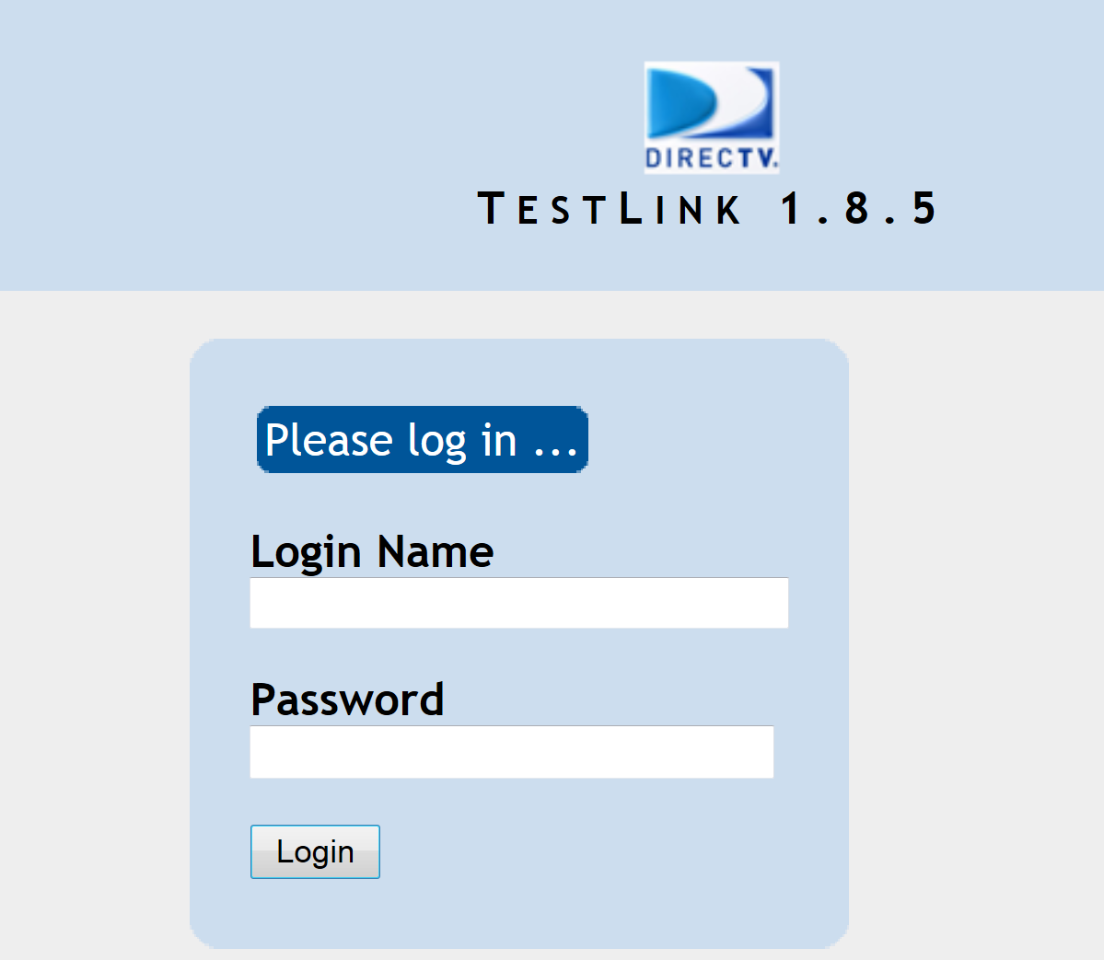
Overview
This course will guide through normal workflow of a test leader when working with TestLink.

Slide 3
What a Test Leader needs to know?
Execute testcase
How to create and modify Test Plan.
How to add/remove Test Cases in Test Plan.
How to assign Test Cases to testers.
How to add/remove Test Cases in Master Test Suite.
View report metrics and test results.

Slide 4
Execute testcase
A test leader also needs to know how to execute test case as a tester: Please refer to Testlink For Tester.pptx for more information.

Slide 5
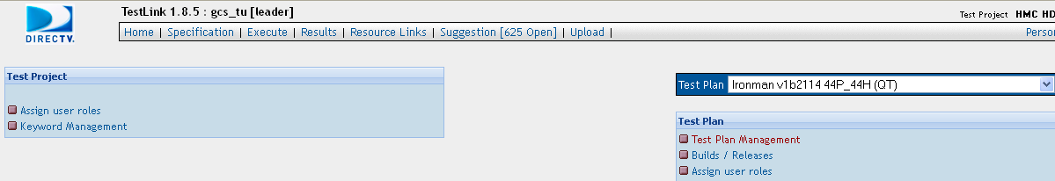
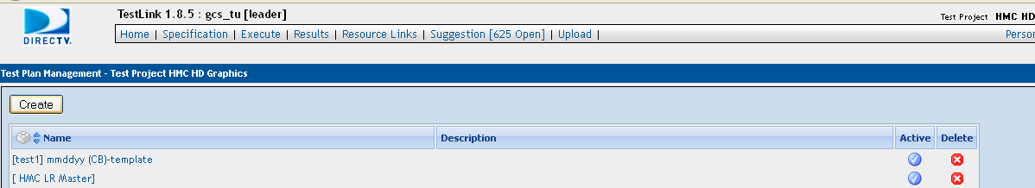
Create a Test Plan
Before starting to test a new build, we have to create a Test Plan for it.
Click on "Test Plan Management" to open the "Test Plan Management" page. Then click on "Create" button to open the Test Plan details page.

Slide 6
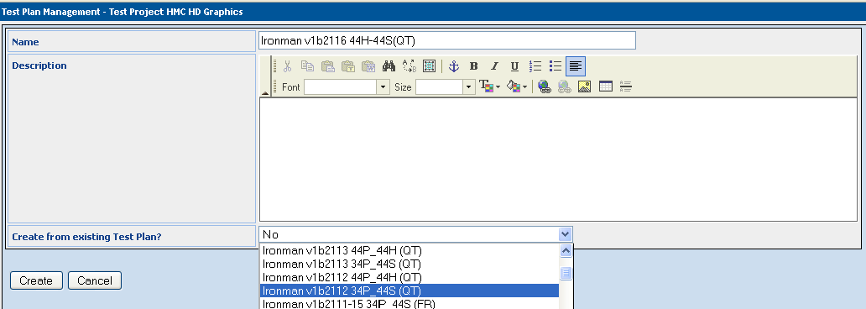
Create a Test Plan (cont.)
The Test Plan name and its description should be fill in correctly.
If the Test Plan is created from an existing Test Plan, we select the existing Test Plan to replicate it (the items that are copied include: builds, test cases, priorities, milestones, and user roles). Otherwise, select "No".
Click on "Create" button to create the Test Plan.

Slide 7
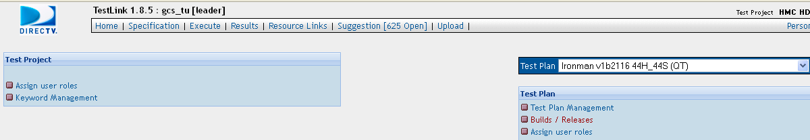
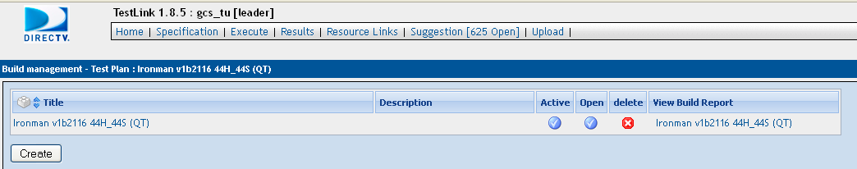
Create a Test Plan (cont.)
After creating the Test Plan, we have to add Test Build to it.
Select the Test Plan you want to add builds then click on "Builds/Releases" to open the "Build Management" page. And then, click on "Create" button to open build details page.

Slide 8
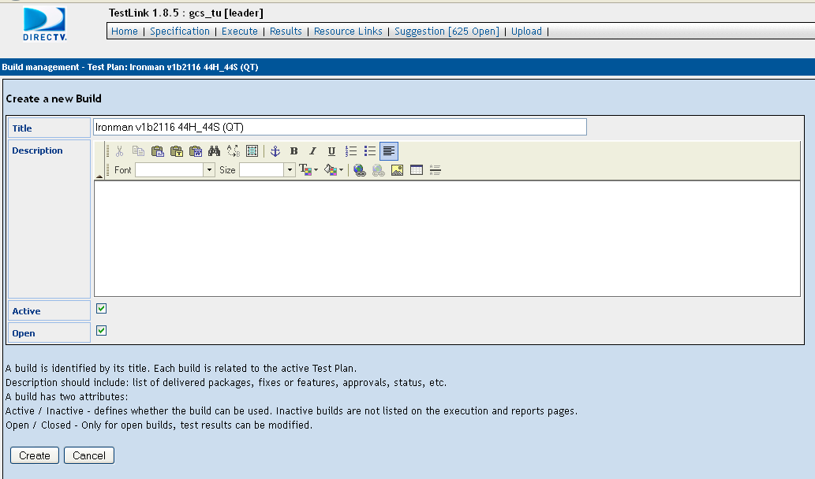
Create a Test Plan (cont.)
The title of the Test Build must be the same as the Test Plan.
Active /Inactive – defines whether the build can be used.
Open /Closed – Only for open builds, test results can be modified.
Click on "Create" button to create the build.
Description should include: list of delivered packages, fixes or features, approvals, status, etc.

Slide 9
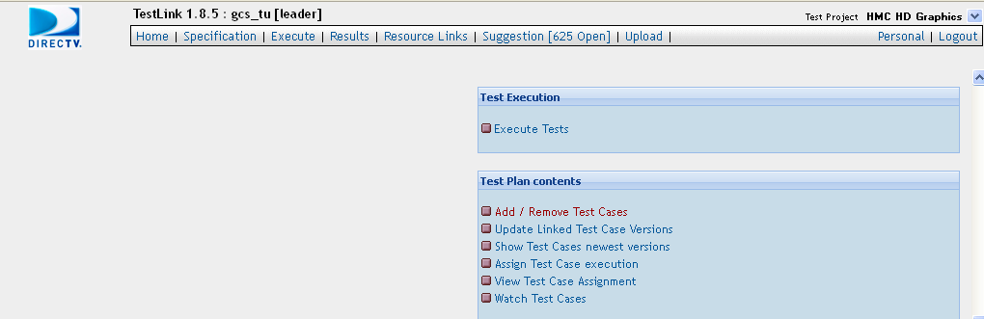
Add /Remove Test Cases to a Test Plan
We can add more test cases to a Test Plan or remove existing test cases out of the Test Plan.
Select the Test Plan you want to add or remove test cases, then click on "Add /Remove Test Cases" to open the "Add /Remove Test Cases" page.

Slide 10
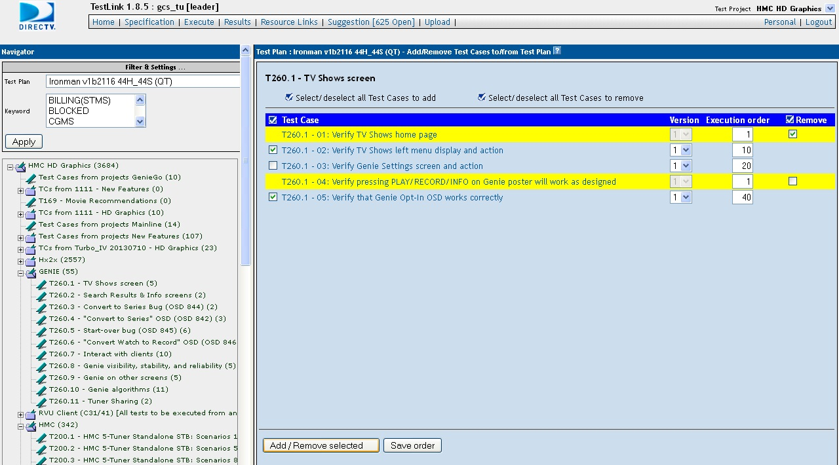
Add /Remove Test Cases to a Test Plan (cont.)
Select a Test Suite on the left panel to get the list of test cases. Test cases with yellow highlight are being added to the Test Plan.
Check on "Test Cases" to add them into the Test Plan.
Check on "Remove" to remove the test cases out of the Test Plan.
Click on "Add/Remove selected" to add and remove selected test cases.

Slide 11
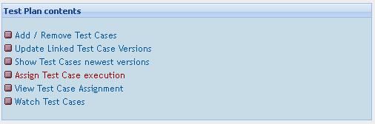
Assign Test Cases to Testers
Test Leader has to assign test cases to Testers as assignment of the test build.
Select the Test Plan you want to assign test cases then click on "Assign Test Cases execution" to open the "Assign Test Cases" page.

Slide 12
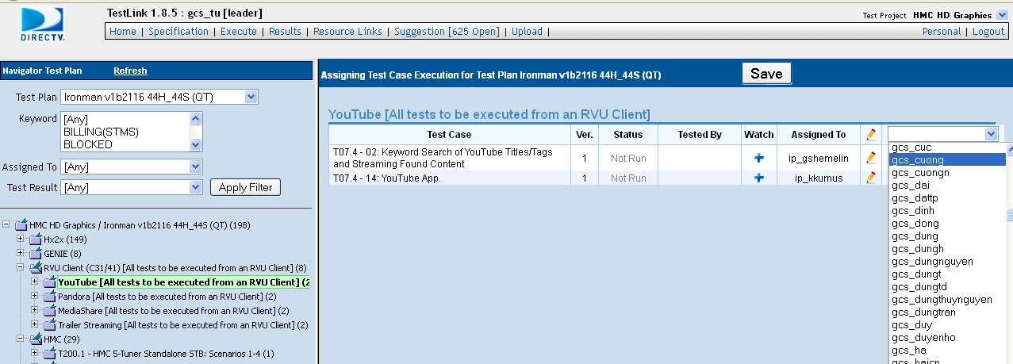
Assign Test Cases to Testers (cont.)
Select a Test Suite on the left panel to get the list of test cases . Click on the yellow pen on the right side to get the list of testers. Then select a tester to assign the test case to that tester.
Click on "Save" button to save the assignment.
We can narrow down the list of test cases by filtering "Assigneed To" and "Test Result" on the left panel.

Slide 13
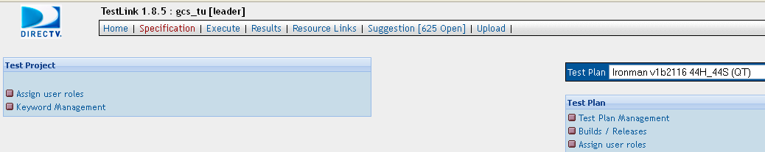
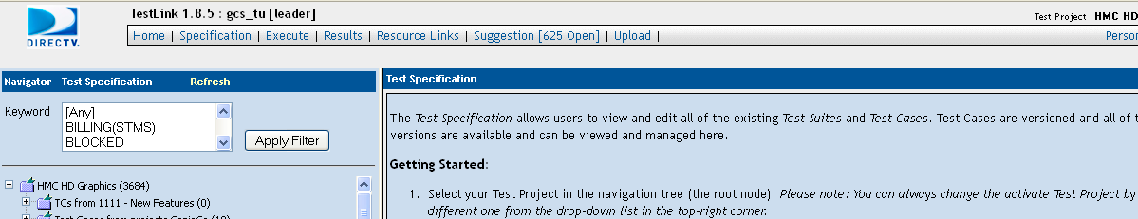
Add /Remove Test Cases in Master Test Suite
We can add or remove test cases in Master Test Suites.
Open "Test Specification" by clicking on "Specification" tab to add or remove test cases in Master Test Suites.

Slide 14
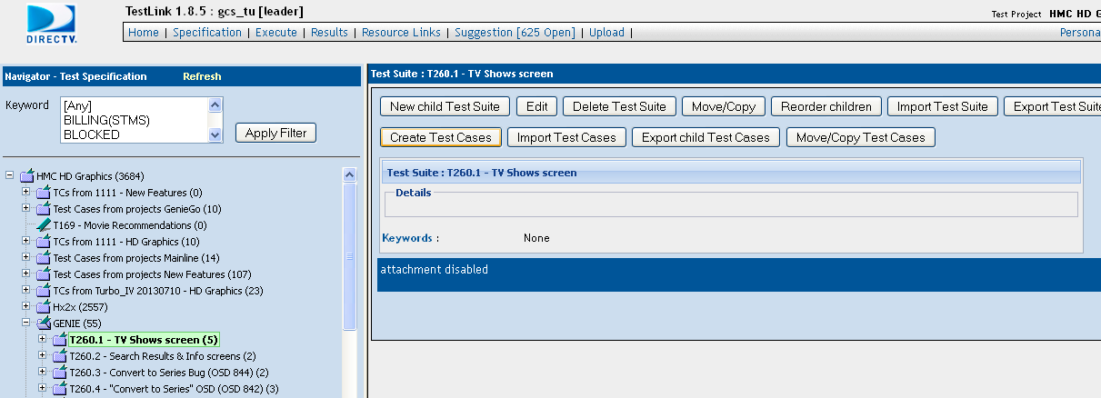
Add /Remove Test Cases in Master Test Suite (cont.)
Select a Test Suite on left panel to add new test cases.
Click on "Create Test Cases" button to open the "Create Test Cases" form.

Slide 15
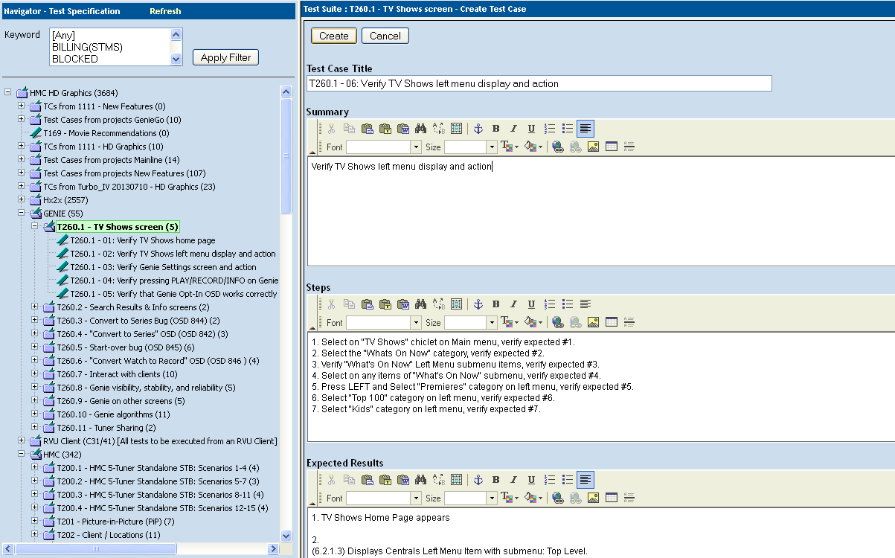
Add /Remove Test Cases in Master Test Suite (cont.)
Fill in Test Case Title, Summary, Steps and Expected Results of the test case.
Click on "Create" button to create the test case.

Slide 16
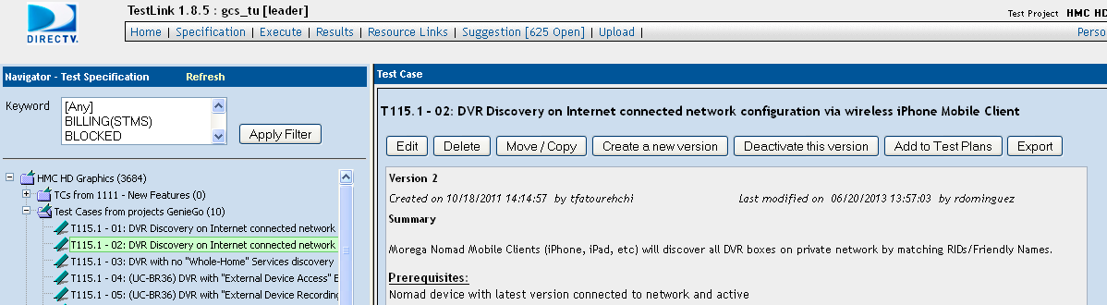
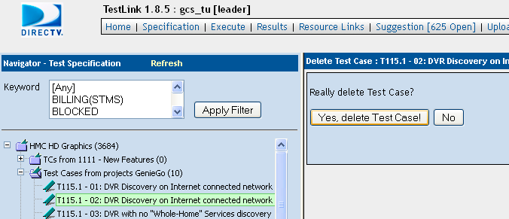
Add /Remove Test Cases in Master Test Suite (cont.)
Select a Test Case to be deleted on the left panel.
Click on "Delete" button to delete the test case.
Click on "Yes, delete Test Case" button to confirm the deletion.

Slide 17
What Managers need to know?
How to view reports and metrics
How to view test results

Slide 18
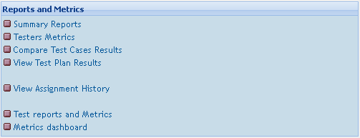


View Reports and Metrics
TestLink provides plenty of reports and metrics to help managers view static data about Project, Test Plan, Test Case, Testers, …
Summary Reports: return overview information of queried Test Plans, queried JIRA issues, queried most recent Test Plans.
Testers Metrics: return summary data about Test Plans including clearly assignment of each Testers and Test Cases.
Compare Test Cases Results: return the test results of each Test Cases of compared Test Plans.
View Test Plan Results: return detail test results of a Test Plan.
View Assignment History: return the assignment history of each Test Cases.
Test Reports and Metrics: return summary test results of all Test Plans.

Slide 19
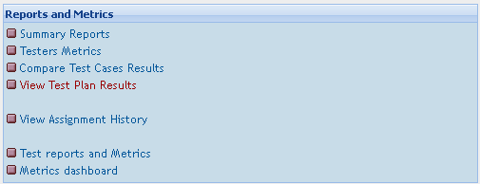
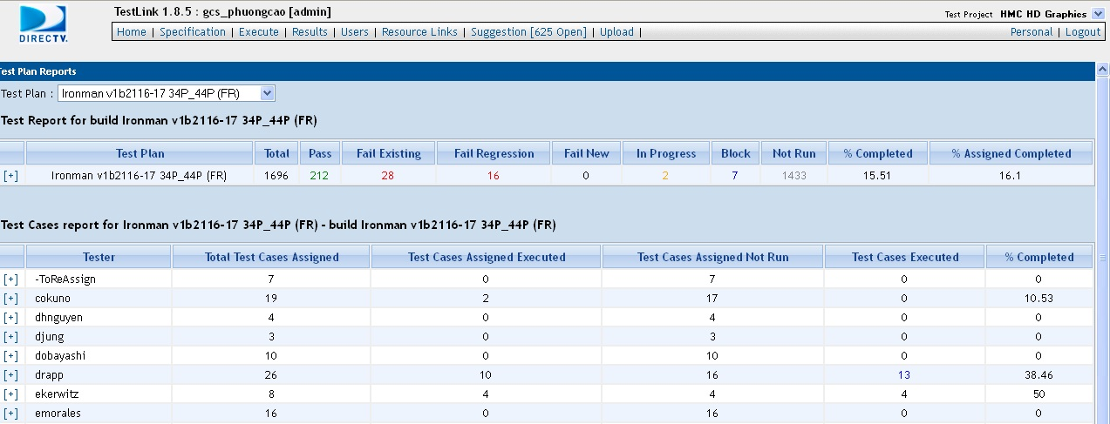
View Reports and Metrics (cont.)
For example: I want to view detail test results of Test Plan "Ironman v1b2116-17 34P_44P (FR)", I select the Test Plan then click on "View Test Plan Results" => The Test Plan report will be displayed.

Slide 20
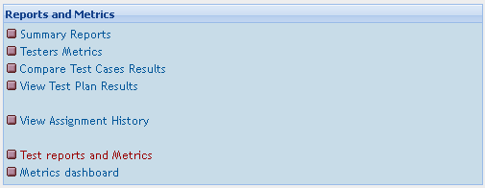
View Reports and Metrics (cont.)
Testlink also allows users to export Reports and Metrics in Word, Excel, OpenOffice and HTML format.
To export a report or metric, click on "Test Reports and Metrics"

Slide 21
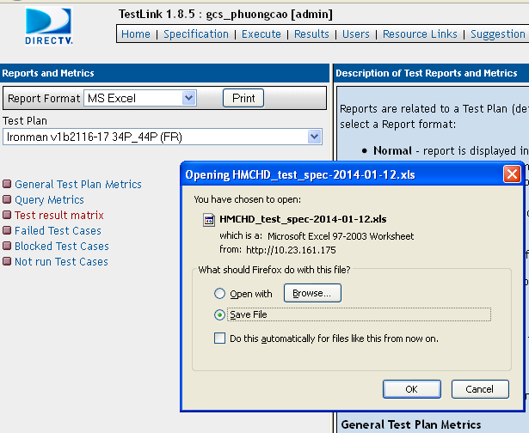
View Reports and Metrics (cont.)
Select the Report Format you want.
Select the Test Plan.
Select the report you want to view.
→ You will be prompted to open or save the file.
Wait for the download completed then open the file.

Slide 22
Thank you

